Slide 1

Career Exploration
Chapter 1, Lesson-1-2

Slide 2
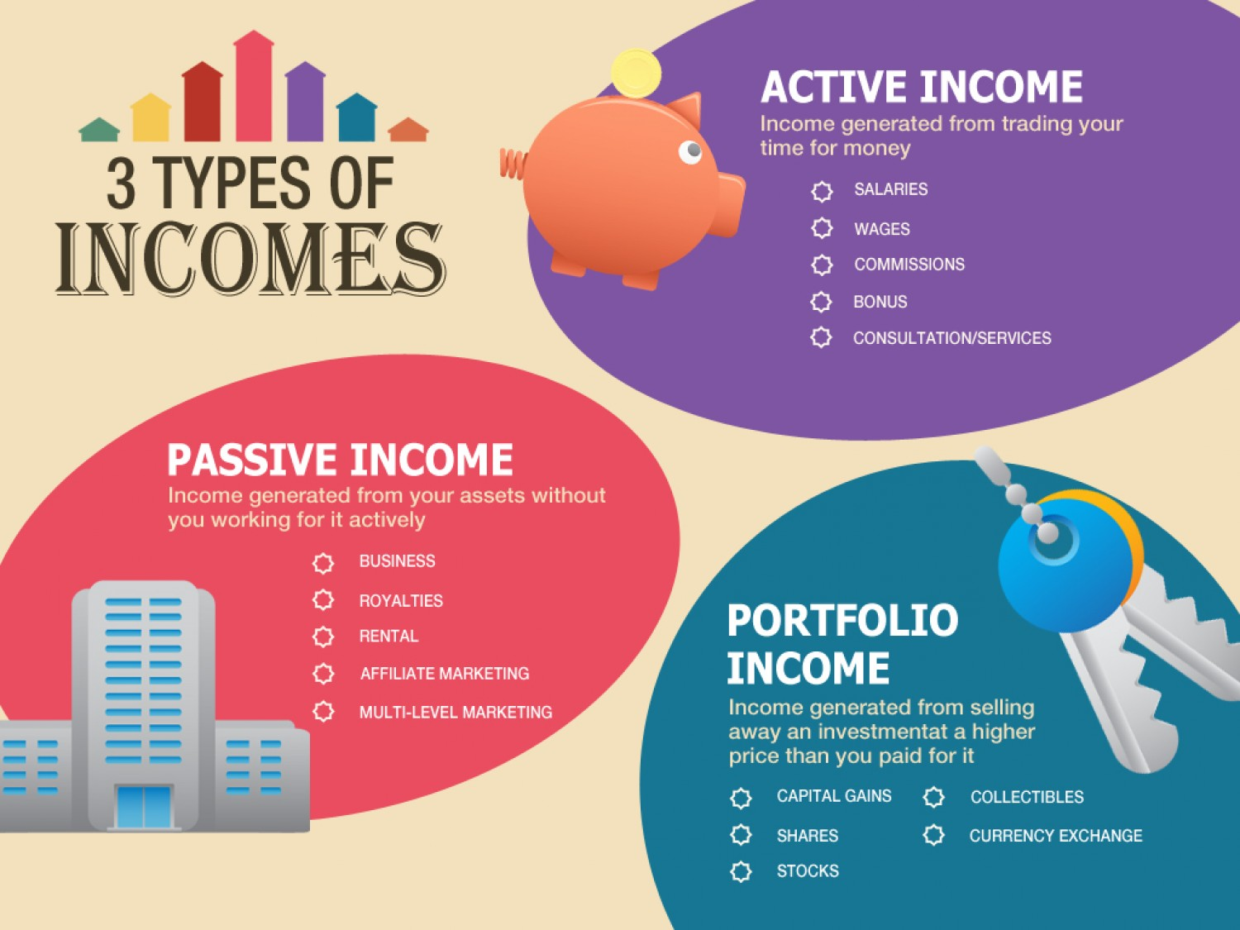
Objectives
Job Versus Career
How to Research Your Career Choice
What does the job market look like?
Test – Research and create a presentation on your career choice

Slide 3
Career versus Job
Job: Position obtained mainly to earn money (in high school/college)
Example: Grocery Store Attendant, waiter
Career: A commitment to a profession in a field that you find interesting and fulfilling
Example: Educator, Electrician, Welder, Doctor, Lawyer

Slide 4

To be happy in what you do for a living, you need three things:
1. You need to be good at it,
2. It must come easily for you 3. and you must enjoy it!

Slide 5


Table Talk Career Exploration
Group Discussion Why is Career choice important?
Recorder = Student with Most siblings
Discussion Topic: “Career choice, why is it important and what will it impact in the future?”
Student contributions – you need 5 – 6 answers. You will submit 2 that no one else submits before you!

Slide 6
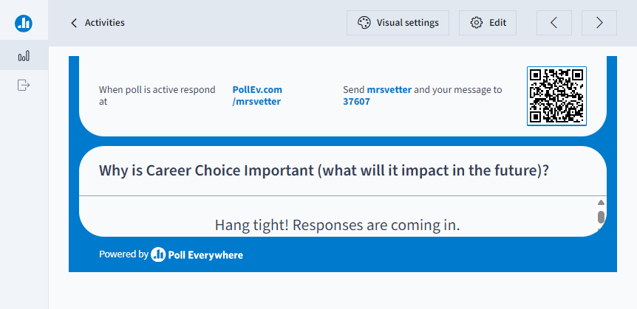

Slide 7
Why is Career Choice Important?
Education needed
Living arrangements – own or rent, size, cost….
Size/health of your Family
What you own, drive, can afford
Where you live
Determines your budget
Fulfill your wants not just your needs
What you contribute to society

Slide 8


Slide 9
Did you Know
1/3 of your life will be spent at work.
That’s 90,000 hours over the course of a lifetime.
The average American spends over 100 hours commuting.
By the age of 30, most people will have had 7 or 8 jobs.
80% of workers hate their jobs.

Slide 10
What do Careers of the future Look Like
Driven by Technology - Better, faster ways of getting things done
Will Change Frequently:
Continually updating your current and new skills
Retraining
Businesses are brick-and-mortar & internet based
Green mentality? – environmentally friendly
Global – reach around the world
10 minutes

Slide 11
CAREER SELECTION IS IMPORANT
Selecting a career that is interesting and fulfilling results in
BEING HAPPY
Develops your personal and financial goals – (how you will spend, save, invest, protect)
Provides for your needs, and creates what you want
Defines your future

Slide 12
How to Select a Career
Assess yourself
List several Occupations you may explore
Explore your career options
Choose a Career and Develop a Career Plan

Slide 13
1. Assess Your Self
Know your values, interests, soft skills, and aptitudes
Take self assessment tests to match your values/interests and aptitudes to current jobs
Some people choose to work with a career counselor or other career development professionals who can help them navigate this process
We will try one:
Go to google classroom and take the assessment and answer the questions
https://www.mynextmove.org/

Slide 14
2. List several Occupations you may explore
Make a list of jobs you may be interested in
Based on your interests and assessments create a list of careers
From your assessments
From what you have considered
From your interests
Interviews of people in careers you may want to do
Narrow your list to several options
Research to determine your best fit

Slide 15

Assessment and List Options Assignment
Take the Self Assessment at https://www.mynextmove.org/
Google Classroom: After completing the self assessment, answer the questions from the results of the assessment

Slide 16
3. Explore career options
Review job descriptions and educational, training, and licensing requirements in published sources
Three US government publications to use for Researching a Career
The Occupational Outlook Handbook (OOH) – tells expected job growth for the next 10 years, median national earnings, number of openings, and work environment description
O*NET: Dictionary of Occupational Titles (DOT) – tells the employee level requirements: education, skills, abilities, and median wages of each type of job and wages by state.
Monthly Labor Review – articles on current information about specific occupations
We will look at the first two only.

Slide 17
3. Explore career options
The Occupational Outlook Handbook (OOH)
Found on the Bureau of Labor Statics Website https://www.bls.gov/ooh/
Select Publications menu and the OOH
Used to find the future outlook of a career?
National Wages, job openings in the future
Example: Fitness Trainer

Slide 18
Web Project Career Outlook
Use the OOH – Occupational Outlook Handbook. Link found on Google Classroom.

Slide 19
3. Explore career options
The O*Net
Found at https://www.onetonline.org/
Online database of job descriptions listing:
Tasks
Knowledge
Skills and abilities
Wage Information – both National & State
Example: Fitness Trainer

Slide 20
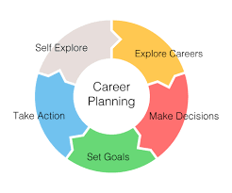
4. Choose a Career and Develop a Career Plan -
Written document that lays out all the steps you will have to take to reach your goals.
Think of it as a road map that will take you from point A to B, then to C
Choose a career
Set a SMART Goal to get that career
Take Action

Slide 21
Test Career Choice Test – What Is your pLan
Research the Career
Create a Presentation with the details of your career
Write a Quick Plan of how you will go about getting that career.

